Slide 1
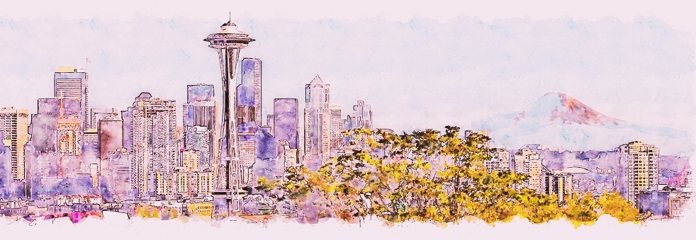
Sushi Restaurant in Seattle

Slide 2
Introduction
The City of Seattle, is the city that most closely connected to Japan in the United States. It provides lot of opportunities and necessary environment for business related to Japan.

Slide 3
Business problem
Seattle is the hometown for many famous cuisines that was developed by the Japanese coming here, like teriyaki. Ramen or Sushi restaurants have become so popular in this area and even in the United States. Starting a sushi restaurant can be a great business opportunity, but it is necessary to distinguish yourself from others by ingredients and materials.
If you plan a real restaurant that can demand higher prices for fresh fish, delivered daily from Japan, focus on neighborhoods and outlets that already attract a sophisticated Japanese client. If you plan a cheap buffet restaurant, points to the masses looking for affordable high-traffic locations with large shopping centers and other local points of interest. So it is evident that to survive in such competitive market it is very important to startegically plan. Various factors need to be studied inorder to decide on the Location

Slide 4
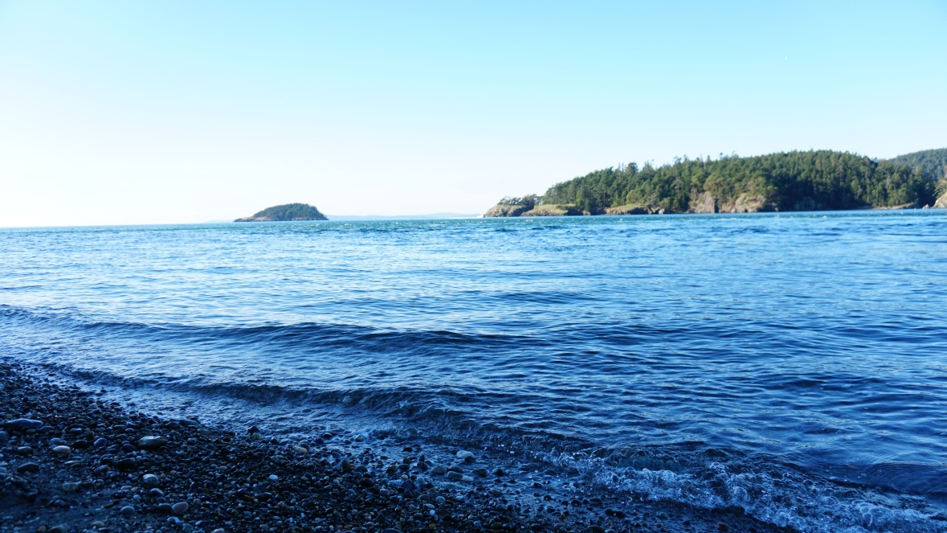
Target Audience
My target audience is anyone who wants to open business in Seattle downtown, near the port, so I only focus on that borough during my analysis. The objective is to locate and recommend to the manager which neighborhood of Seattle will be best choice to start a restaurant.
This would interest anyone who wants to start a new Japanese or seafood restaurant in Seattle.

Slide 5
Data
To find the best location for the sushi bar, we will use the following sources of information:
Here is the link to the dataset of neighborhood of Seattle: https://github.com/seattleio/seattle-boundaries-data/blob/master/data/neighborhoods.geojson
From Foursquare Venues Categories - https://developer.foursquare.com/docs/resources/categories Sushi category Id - 4bf58dd8d48988d1d2941735

Slide 6
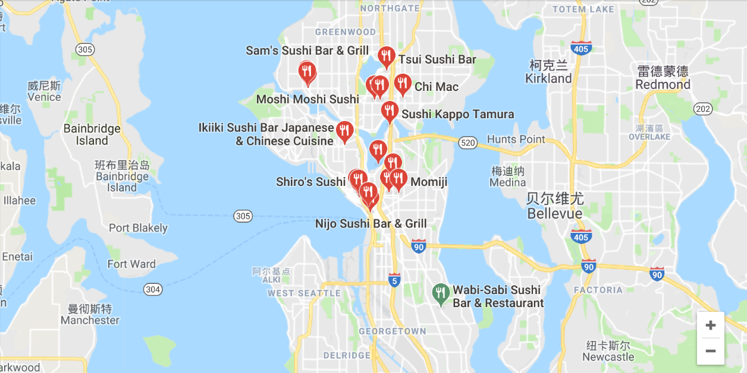
Method
Using features to group the neighborhoods into clusters K-means clustering algorithm will be use to complete this task. And also, the Folium library to visualize the neighborhoods in Seattle and its emerging clusters.

Slide 7
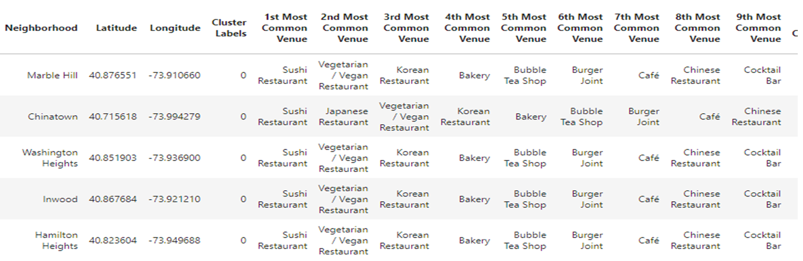

Slide 8
